Slide 1

Swift~buy Enterpice
Any location, anytime

Slide 2

INTRODUCTON
Data Analytical Overview
Problem Identification
Data Visual
  Total Profit by location(Top 5)
  Total Sales Price by Product Category
  Mode of payment by Total Price
Global business scaling
  Global Business Expansion
  Global Business Ranking
Annual Performance Comparison
Theory
Conclusion

Slide 3
DATA ANALYTICS OVERVIEW
An analytical review of performance, metrics, trends
and data given recommendation.
GREAT INSIGHTS
Presented By
Greg Uchenna
Department
Data Analytics

Slide 4

Problem Statement — Shift~Buy Enterprise
Shift~Buy Enterprise needs a clearer understanding of its sales performance, profitability, and regional market performance to make informed business decisions.
Without a comprehensive analysis of sales data, management may struggle to identify the most profitable products, recognize underperforming locations, understand sales trends, and determine where improvements are needed.
This project aims to analyze sales data, identify performance patterns, uncover potential business weaknesses, and provide data-driven recommendations to improve profitability and support business growth.

Slide 5
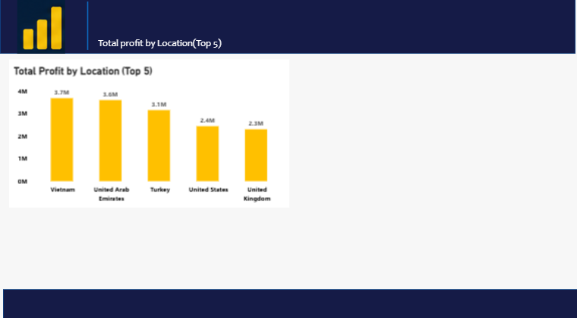
Fi
Regional Profit Review
Purpose of the Visual
To compare the total profit generated by different locations and identify topo 5 location based on profit
2. Explanation of the Visual
The bar chart displays total profit for each of the top countries. The length of each bar represents the profit amount, making it easy to compare performance across locati0ons
3. Key Finding
The chart shows the Vietnam generates the highest profit among the top five location. While Canada with the lowest profit
4. Business Implication
The business must focus on the reason why Vietnam has such a strong performance and use that factor to improve profitability in lower performing locations

Slide 6
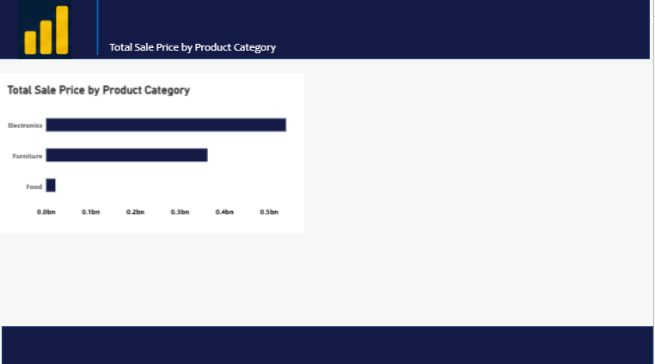
Product Category Sales Analysis
Purpose of the Visual
To show the total sales generated by each product category and help compare their performance across the business.
2. Explanation of the Visual
The horizontal bar chat displays the total sales for each product category. The length of each bar represent the sales amount, making it easy to compare which categories perform better than the others
Business Implication
The business can focus more on high performing categories like Electronics and Furniture, while exploring strategies to boost the lower performing category
3. Key Finding
Electronics has the highest total sales value, Furniture is the 2nd and Food is the Lowest

Slide 7
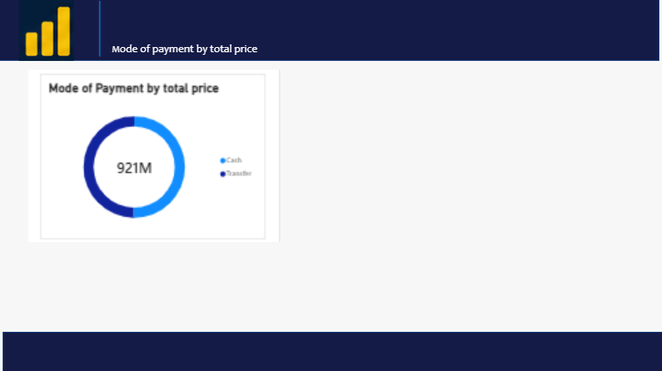
Payment Method Analysis
Purpose of the Visual
To compare the proportion of total transactional value accounted for by either cash or transfer
2. Explanation of the Visual
The visual shows that the transfer accounts for 49.82% of the total, while the Cash accounts for the remaining 50.18%.
3. Key Finding
Cash accounts for a slightly larger share of the total transaction value than transfer but the difference is only 0.36 percentage points
Business Implication
Both payment methods contribute almost equality to the total transaction value, so the business should continue accommodating both methods

Slide 8
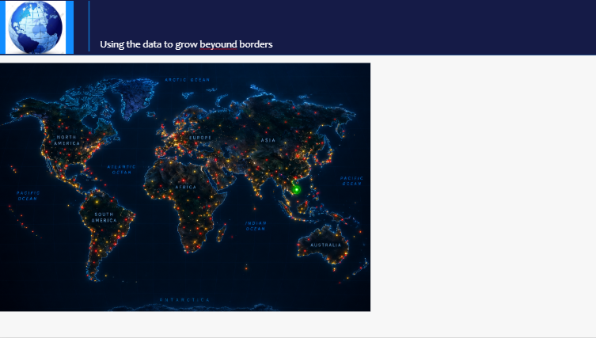
Global Business Expansion Analysis
Key point
Comparing performance by analysing sales, profit and demand in different, regions to find the best performing market
Focusing on Locations with strong sales and profit for faster expansion
Finding areas with low performances to improve them
Supporting international investments decisions with reliable data

Slide 9


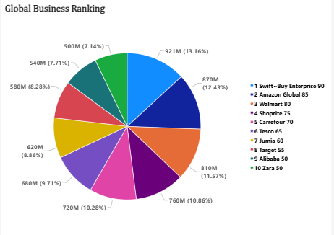
Global Business Ranking
Purpose of the Visual
To show company/enterprise global ranking and total profits and percentage value
2. Explanation of the Visual
The visual show top 10 global companies and each company at 1, with their establishments across the world
3. Key Finding
The ranking of Swift~buy enterprise as 1st, with a total of 90 establishment, 921million total sales and percentage
4. Business Implication
From the chart, Swift~buy holds a massive record and at the top of the business industry

Slide 10
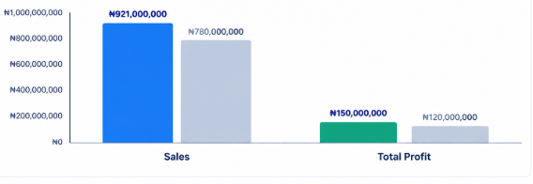
Annual Performance Comparison
Sales growth
Revenue increased by 18.1%, from ₦780 million to ₦921 million.
Profit growth: Total profit increased by 25%, from ₦120 million to ₦150 million.
Business performance
Both indicators improved compared with the previous year.
Recommendation
Investigate the products, locations, and sales channels contributing most to this growth, while monitoring operating costs to sustain profitability.
Conclusion
The comparison shows that Swift~Buy Enterprise achieved higher sales and profit this year than last year. Management should build on this performance by identifying the main drivers of growth, strengthening profitable business areas, and addressing any underperforming segments.

Slide 11
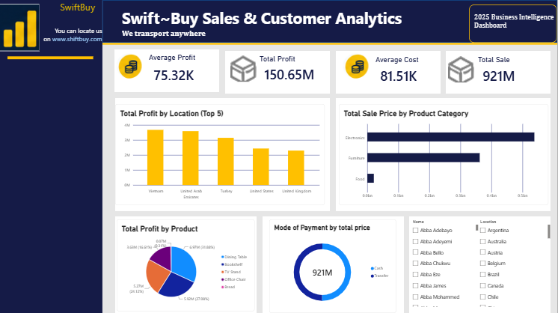
Overview
Sales Analysis
Customer Analysis
Product Analysis
Region Analysis
Trend Analysis
Forecasting
Alerts

Slide 12


Conclusion
The shift~ buy enterprice data analysis project helps evaluate sales and profit performances across countries, product categories, payment methods, etc the insight obtained support better business decision, improve performance ma d identify growth opportunity

Slide 13
Thank You

